Slide 1
March 25, 2014
Board of Governors Meeting
Finance
Customers
Campus
Authority

Slide 2
Financial Snapshot
Profit/Loss
Projected
$367,147
$981,289
$63,654
Actual
593,907
1,255,237
72,139
Projected YTD
1,150,022
23,590,019
184,178
Actual YTD
843,731
25,397,889
189,932
H/M Tax
Customers
(Estimated)
Economic
Impact
Actual $15.7M
2.81%
203,667
98.7M
Budget $16.2M
FY13 $15.6M
.49%
(Estimated)

Slide 3
College Football
Hall of Fame Update
John Stephenson
President, Atlanta Hall Management

Slide 4
Centennial Olympic Park
Event Update
Julia Karrenbauer
Director of Business Development

Slide 5
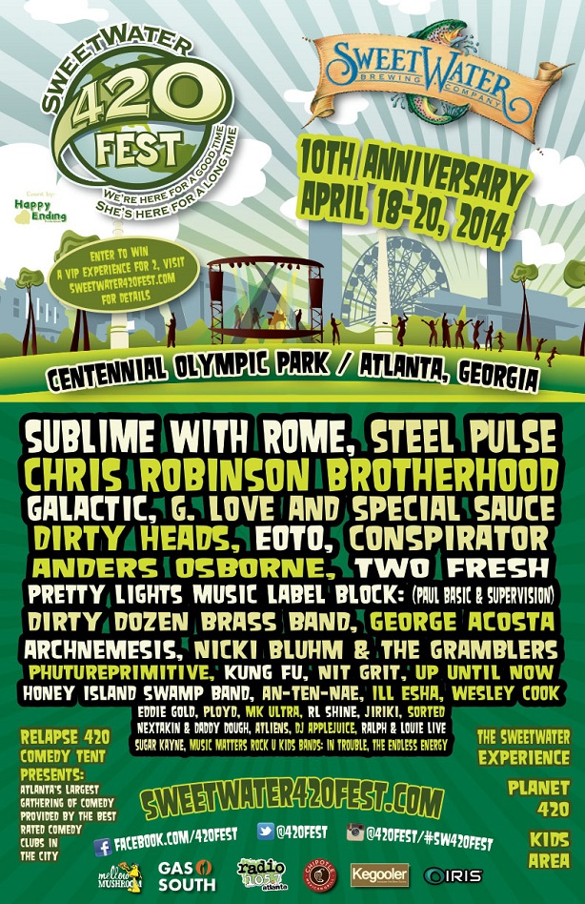
Sweetwater 420 Festival
Dates: April 18-20
3 Day Festival – Beer, Food, Music
10 year history of the event
New five year deal at the Park
420 Fest 5k – 3,000 people
Projected attendance for entire event- 30,000
Ticketed for first time

Slide 6

Party in the Park
Date: May 17
3rd year of self-produced event
Line up – GirlTalk, MGMT, The Joyformidable, Stokeswood, and one other band TBD
Revenue Opportunities
Ticket Sales
Facility Fee
Food and Beverage
Sponsorships
Merchandise
Projected attendance – 9,000

Slide 7
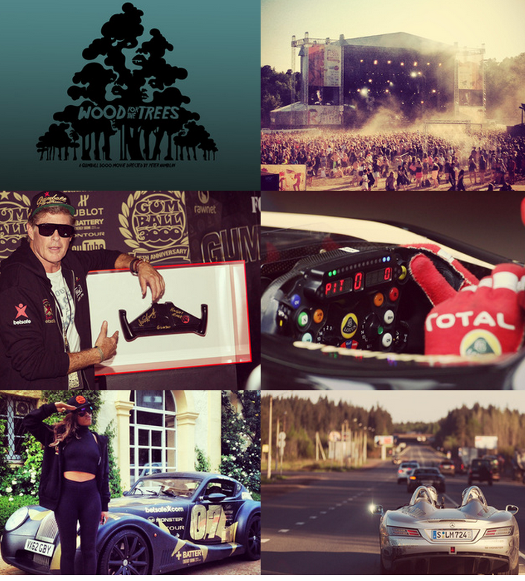
Gumball 3000
Date: June 5
Premier Lifestyle brand
Hosts rally of 125 luxury cars that travel cross-country from Miami to Ibiza (3000 miles)
After 15 years, first time adding Atlanta to their route (COP)
Projected attendance: 10,000 – 15,000
Nightly concert and/or party at each stop

Slide 8
Event Development
Billboard Touring Conference
Pollstar Live Conference
EDM

Slide 9
Georgia Dome Update
Crowd Management
Services Agreement
Carl Adkins
General Manager

Slide 10
Background - Contemporary Services Corporation (CSC)
Dome is obligated by license agreement with the Falcons to provide crowd management services for all Falcons games.
Crowd management services includes Event Staff such as Security, Ticket Takers, Ushers and Event Staff Supervisors
We contracted with CSC in 2002 to provide these services for Falcons games and all publicly ticketed events held in the Dome
  The agreement has been renewed twice since – in 2005 and in 2009
  Current agreement expires June 30, 2015

Slide 11
Background - Continued
CSC presently provides services to 25% of all NFL Stadiums
For the 2013 Falcons season, the Dome paid CSC $1.2M – or an avg. of $120K per game
The total value of the contract includes other publicly ticketed events
  Estimated at $1.1M billable to customers

Slide 12
Terms – CSC Agreement
Scope of services would remain the same
By renewing now, we can forgo a $1.00 hourly increase scheduled for July 1, 2014 – until July 1, 2015
  This would represent a savings of $65K in the Dome FY15 budget and would save our publicly ticketed events in staff cost next year
Under proposed renewal, rates would increase by $1.00 per hour beginning July 1, 2015, and would remain flat through life of Dome or June 30, 2017
Questions?

Slide 13
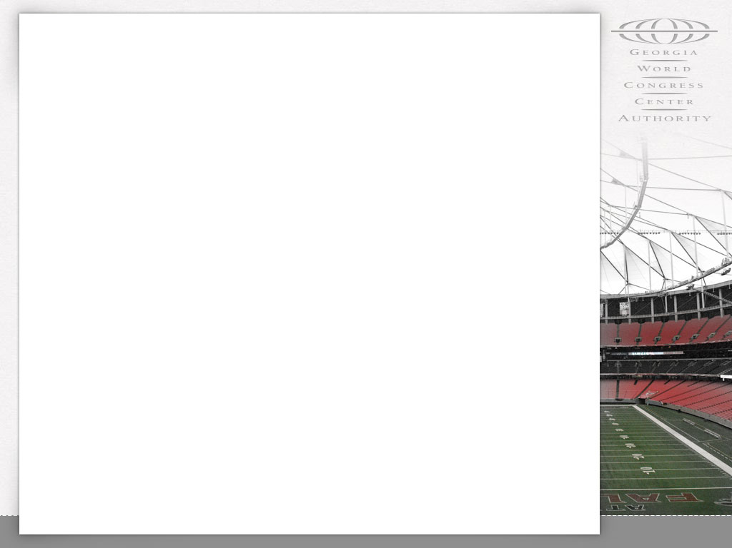
Board Action
WHEREAS, the Authority and Contemporary Services Corporation (“CSC”) entered into that certain Agreement dated August 19, 2002 (the “CSC Agreement”); and
WHEREAS, the term of the CSC Agreement, as previously amended, currently is to expire on June 30, 2015.
NOW, THEREFORE, BE IT RESOLVED by the Board of Governors of the Geo. L. Smith II Georgia World Congress Center Authority that:
Notes:
WHEREAS, the Authority and Contemporary Services Corporation (“CSC”) entered into that certain Agreement dated August 19, 2002 (the “CSC Agreement”), which CSC Agreement subsequently was amended by agreement of the parties on June 21, 2005 (the “First Amendment”), December 22, 2009 (the “Second Amendment”), September 21, 2012 (the “Third Amendment”), and February 20, 2013 (the “Fourth Amendment”), essentially for the provision of contract crowd management services in the Georgia Dome during events; and

Slide 14
Board Action - Continued
The Executive Director is authorized, though not required, to negotiate a written agreement with Contemporary Services Corporation (“CSC”) pursuant to which the Authority’s Agreement with CSC, as previously amended, would be extended to expire not later than June 30, 2017.
Staff recommends approval.
Notes:
WHEREAS, the Authority and Contemporary Services Corporation (“CSC”) entered into that certain Agreement dated August 19, 2002 (the “CSC Agreement”), which CSC Agreement subsequently was amended by agreement of the parties on June 21, 2005 (the “First Amendment”), December 22, 2009 (the “Second Amendment”), September 21, 2012 (the “Third Amendment”), and February 20, 2013 (the “Fourth Amendment”), essentially for the provision of contract crowd management services in the Georgia Dome during events; and

Slide 15
GWCCA
Bylaws Change
Frank Poe

Slide 16
Resolution - GWCCA Bylaws Change
Article VI – Officers
Article VII – Powers and Duties of Officers
  Add Savannah General Manager and Assistant General Manager to GWCCA Bylaws

Slide 17
Board Action
WHEREAS, more than thirty (30) days have passed since a proposed amendment to the Bylaws, in the form attached hereto as Exhibit A, was, in writing, distributed in person or by mail to the members of the Board.
NOW THEREFORE, BE IT RESOLVED by the Board of Governors of the Geo. L. Smith II Georgia World Congress Center Authority that the Bylaws hereby are amended and new Bylaws are adopted in the form attached hereto as Exhibit A.
Staff recommends approval.

Slide 18
Board Planning Retreat
Wednesday, September 24, 2014
Thursday, September 25, 2014
Friday, September 26, 2014

Slide 19
Executive Session
Real Property Acquisition

